Slide 2
AIMS OF THIS SESSION
To explain why reading is important
To explain what reading takes place in school
To explain how we promote reading
To give suggestions for how you can help

Slide 3
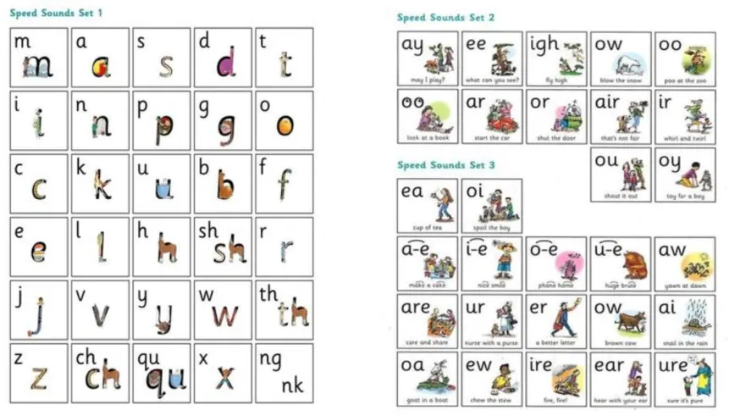
PHONICS SESSIONS
SOUNDS

Slide 4
PHONICS SESSIONS
LETTER FORMATION

Slide 5
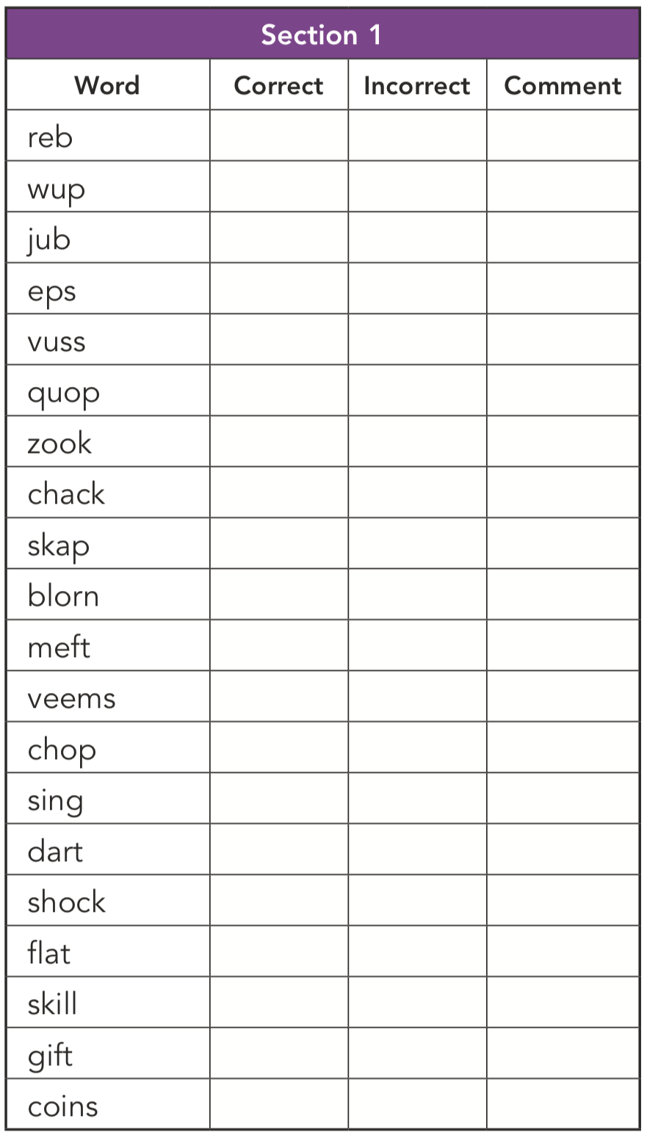
PHONICS SESSIONS
REAL VS ALIEN
SCREENING

Slide 6
SHARED READING SESSIONS YEAR 2 - YEAR 6
Shared reading:
where the class share a text,
identify the genre and its features,
focus on vocabulary and its meaning in context
analysis of the text and grammatical features
questions – oral and written responses
text related tasks
All children will be heard reading at least once a week by their class teacher, whether through their shared reading or reading on a 1:1 basis. This will be recorded in their reading records using green ink, so it is easy to spot.

Slide 7
COMPREHENSION LESSONS
Every class has one extra comprehension lesson per week
Heavy focus on the skills for answering questions, including:
finding information from the text
finding information that is not on the page by looking for clues
predicting what might happen next
thinking about characters’ thoughts and feelings
summarising what has been read

Slide 8
LITERACY LESSONS
Throughout the year, each year group uses quality and challenging texts which they base their writing on.
Lesson are planned to ensure a range of genres are covered within writing.
Children spend a longer amount of time focusing on the book, making predictions, evaluating character and events.
This enables them to immerse themselves into the book and have purpose for writing.
Quality reading means quality writing!

Slide 9
HOW DO WE PROMOTE THE LOVE OF READING?

Slide 10
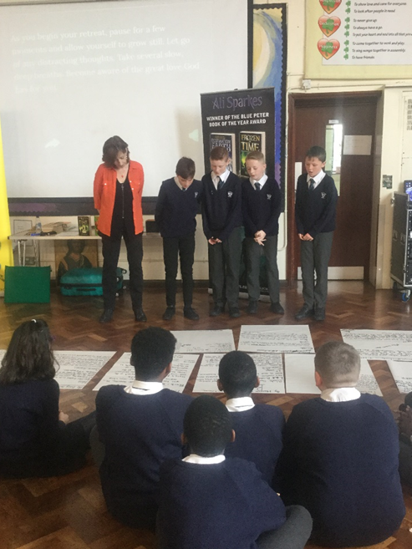
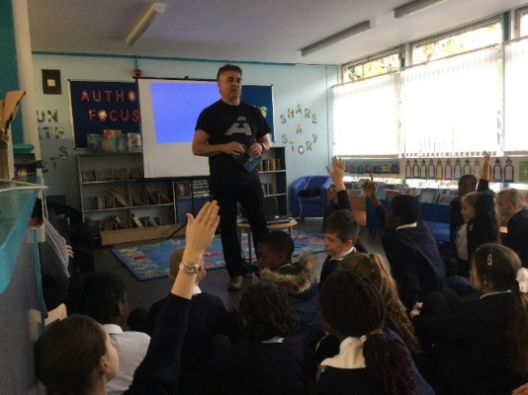
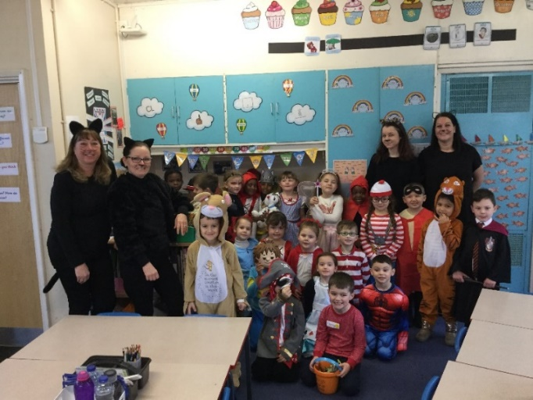
HOW DO WE PROMOTE THE LOVE OF READING?
Library visits (as long as it remains open)
Author visits at the library and at school
World Book Day
Book fair
Literacy week
Exciting and inviting book corners
Allocated quiet reading time
Sharing a book with members of staff
In-school library sessions
Notes:
Reading is promoted throughout the school all year round
Previously we have had library visits - these will continue as long as it stays open - we encourage you to sign your child up to the library
Book fair??
Literacy week - class Swaps, teacher swaps, parent reading sessions
Classroom book corners - lots of hard work put in by teachers last year to make these inviting, creating and exciting for children to want to read
Author visits
World book day - one of our favourite days of the year - a huge celebration of reading and immersing ourselves into our favourite books
Book fair - recently booked
School library - sessions for classes to go and take a book - we are raising money this year to improve the library and make it more inviting and exciting for the children - if you can, please support our fundraising events - we have a donation section on parentpay if you would like to support us further
Allocated time in the week to share a book with a member of staff or independently read for enjoyment

Slide 11
WHAT CAN YOU DO TO SUPPORT YOUR CHILD’S READING PROGRESS AT HOME?

Slide 12
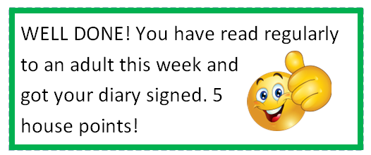
READING AT HOME WITH ENJOYMENT
Make reading visible - have books available in your home if you can
Model reading
Share books every day
Read the books from school
Talk about books
Sit and listen - even if your child can read
Respect choices - any reading is still reading
Read to your child
Please sign the reading record when your child reads - they receive house points if they read 3 or more times a week!

Slide 13
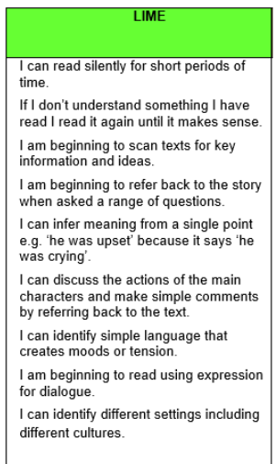
READING BOOKS AND LEVELS
Reading books sent home are colour coded from lilac to black
You may feel that the book is too easy for your child or they can read it with ease
Use questions to develop understanding
Children are assessed by their class teachers
Book band targets in reading records

Slide 14
WHAT TO DO IF YOUR CHILD IS STUCK
Use phonics. What sound does the word begin with? Can you say the sounds? Blend them together
Split the word into syllables - break it down
If the child doesn’t know the word and can’t sound it out, tell them the word and what it means
Ask your child to read to the end of the sentence. What word would make sense?
What is the text about? What word might fit here?
Does it sound right?
If there are images, get your child to look at the pictures for contextual clues

Slide 15
QUESTIONING
What type of book is this? How do you know?
Do you like this book? Why or why not?
Who is your favourite character?
What can you tell me about them?
Which word(s) tell you…?
How do they feel? How do you know?
How would you feel?
What do you think would happen next?
What would you do if that was you?
What does __________ mean? Can you use it in another sentence?
Why has the author used this word/punctuation mark?
Can you summarise what you have read?

Slide 16
THE SKILLS OF READING

Slide 17
THE SKILLS OF READING

Slide 18
THE SKILLS OF READING

Slide 19
THE SKILLS OF READING

Slide 20
THE SKILLS OF READING

Slide 21
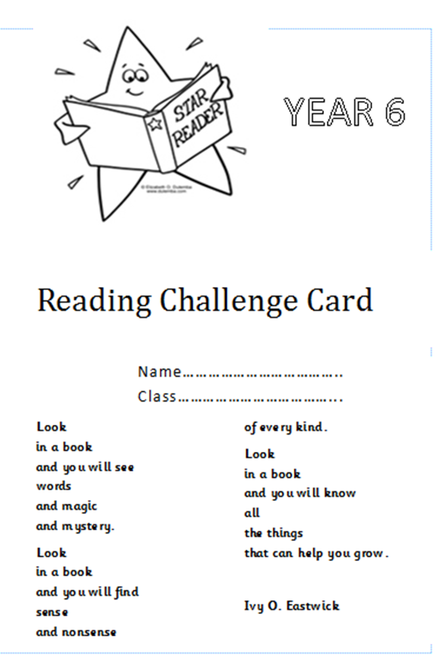
READING CHALLENGE CARDS
Let’s promote reading together!
Years 1 - 6
Includes reading of books/texts from outside of school - home books, local library books, comics, newspapers and more!

Slide 22
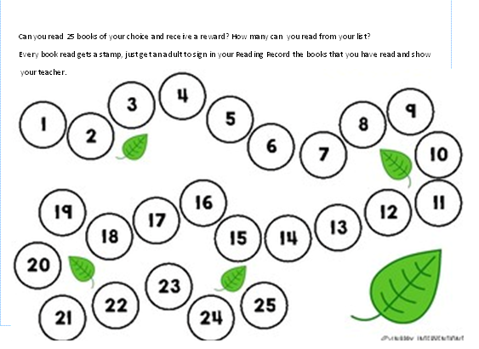
Notes:
These must be written in the reading record by an adult and will be stamped/signed off in the challenge card by a member of staff

Slide 23
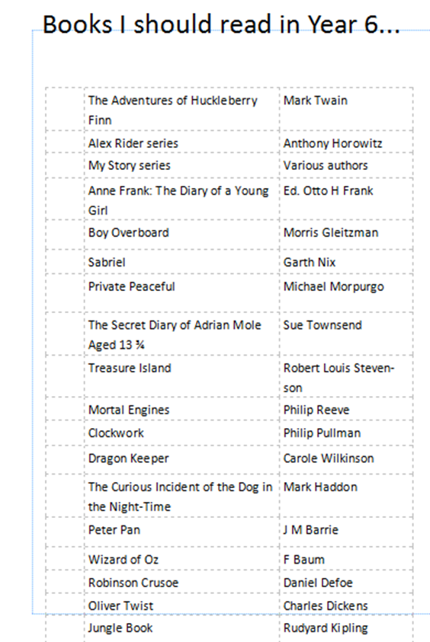
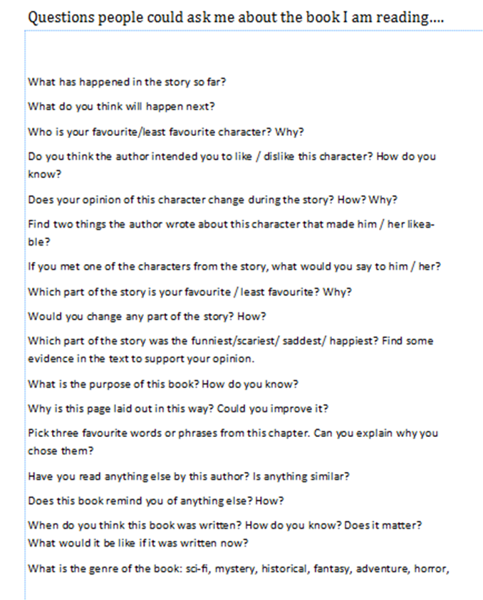
Notes:
Also suggested questions for parents/carers to ask before, during and after reading

Slide 24
ANY QUESTIONS?
THANK YOU FOR LISTENING.
AND DON’T FORGET…

